Slide 1
Accounting and Economics for Engineers (AEE)
Unit - II
Introduction to Financial Accounting

Slide 2
UNIT CONTENTS
Financial Accounting
Definition & Importance
Principles - Concepts & Conventions
Double entry book keeping system
Bases of accounting - Cash basis & Accrual basis
Journal
Ledger
Subsidiary books
Trial Balance

Slide 3
LEARNING OUTCOMES
At the end of this unit students will be able to:
Describe accounting concepts and conventions. (L2)
Understand the double entry system of book keeping. (L2)
Understand bases of accounting and their significance. (L2)
Build journal, ledger and various subsidiary books. (L4)
Describe the purpose and preparation of trial balance. (L2)

Slide 4
FINANCIAL ACCOUNTING
Every trader generally starts business for the purpose of earning profit.
He establishes business with capital, purchases machinery, raw materials, etc., buys and sells goods and incurs some expenses.
At the end of the period he wants to know whether his business has made profit or loss.
For this purpose, he prepares profit and loss account and also to know what he owns (assets) and what he owes (liabilities), he prepares Balance Sheet.

Slide 5
Definition
R.N. Anthony: “Accounting system is a means of collecting summarizing, analyzing and reporting in monetary terms, the information about the business.
American Institute of Certified Public Accountants (AICPA): “The art of recording, classifying and summarizing in a significant manner and in terms of money transactions and events, which are in part at least, of a financial character and interpreting the results thereof.”

Slide 6
Objectives
To maintain the permanent records of the business transactions.
To ascertain the profit earned or loss suffered during accounting period.
To know various business Assets and liabilities apart from the above main objectives.
To know amount due to businessman from his customers.
To know amount payable to Suppliers.

Slide 7
To know various taxes and duties payable to government.
To detect and prevent errors and frauds committed by employees and other person.
To provide valuable information for taking for taking various decisions.
To take decision on significant business matters.
To compare and measure the optional efficiency of his business with other firm, companies in same type of Industry

Slide 8
To review the progress of the business from year to year.
To maintain permanent record of all transactions of business for future reference.
To excise effective control on various expenses, incomes earned over business assets, business liabilities.
Other firms, Companies and within the firm compare current year with previous years. Such comparison is known as infra-firm comparison.

Slide 9
ACCOUNTING PRINCIPLES
The rules and conventions of accounting are commonly referred to as principles.
Accounting principle are general law or rule that is to be used as a guide to action.
It is judged on their general acceptability to the makers and users of financial statements and reports.
They present a generally accepted and uniform view of the accounting profession in relation to good accounting practice and procedures.
Therefore, it is named as “Generally Accepted Accounting Principles.”

Slide 10
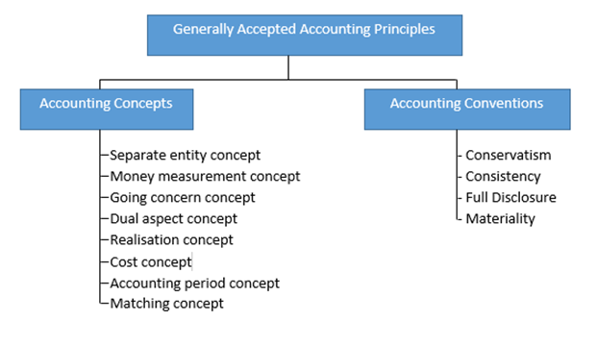

Slide 11
Accounting Concepts
Accounting concepts mean a general idea which conveys certain meaning.
Accounting concepts may be considered as basis assumption or conditions on which the science of accounting is based.
Concepts are based on logical consideration.
Accounts and Financial statements are always interpreted in light of concepts which govern accounting method.

Slide 12
Business Entity Concept:
According to entity concept, business is treated as a unit of entity form separate from its owner, creditors and management, etc.
All business transactions are recorded in the books of accounts from the point of view of business only.
Going Concern Concept:
Business transactions are recorded on the assumption that the business will continue for a long time.

Slide 13
Money Measurement Concept:
Money is common denominator in terms of which the exchange ability of goods and services are measured.
Only such transactions and events as can be interpreted in terms of money are recorded.
Cost Concept:
According to cost concept the various assets acquired by enterprise should be recorded on the basis of actual cost incurred.

Slide 14
Accounting Period Concept:
It is customary that the life of the business is divided into appropriate parts or segments of analyzing the results shown by the business.
Each part divided is known as an accounting period.
Matching Concept:
This concept determines accurate profit/income to compare the revenues of the business with the cost that is incurred to earn that revenue.

Slide 15
Realization Concept:
This accounting concept explains that sell is supposed to be completed only when ownership of goods is passed on from the seller to the buyer.
Dual Aspect Concept:
This concept states that accounting system is set up in such a way that a record is made of the two aspects of each transaction that affects the record.

Slide 16
Accounting Conventions
The term ‘Convention’ denotes customs or traditions or practice based on general agreement between the accounting bodies which guide the accountant while preparing the financial statements.

Slide 17
Disclosure:
According to convention of full disclosure, accounting must disclose all the material facts and information so that interested parties after reading such accounting report can get a clear view of the state of affairs of the business.
Materiality:
The term material means “relative importance” where account should report only what is material and ignore insignificant details while the preparing the final accounts.

Slide 18
Consistency:
This accounting convention state that one’s a particular accounting practice, method or policy is adopted to prepare accounts, statements and reports.
Conservatism:
There are two principles which stem directly from conservatism.
The accountant should not anticipate income and should provide all possible losses, and
Faced with the choice between two methods of valuing an asset the accountant should choose a method which leads to the lesser value.

Slide 19
BASIS OF ACCOUNTING
Cash System of Accounting
Under cash system of accounting entries are made only when cash is received or paid.
No entry is made when amount is due for receipts or payments.
Income is received is accounted irrespective of period for which relates.
Similarly, expenses are restricted to the actual payments made in cash, during the current period is immaterial whether the payments have been made for previous year or subsequent year.

Slide 20
The financial statement prepare under this system do not present a true and fair view of Income, operating results of enterprise.
However, it is suitable in following cases:
For very small business organisation.
For individual to record his own transactions.
For professionals like Doctors, Lawyers, Chartered Accountant, etc.
In cash system financial statements are prepared on the basis of Receipts and payments accounts.

Slide 21
Accrual System of Accounting
This is also known as mercantile system of accounts.
Under this system business transactions are recorded as and when it take place irrespectful of amount / cash received or paid.
Income earned as well as expenses incurred are recorded related to the particular period.

Slide 22
The following are the essential features of accrual basis.
Revenue is recognized on it is earned irrespective of whether cash is received or not.
Costs are matched against revenues on the basis of relevant time period to determined periodic income.
Costs which are not charged to income are carried forward.
Any cost that lost its utility is written off as a loss.

Slide 23
Some Impartment terminologies in Accounting
1. Transactions: Any sale or purchase of goods or services is called the transaction.
Transactions are two types.
Cash transaction: cash transaction is one where cash receipt or payment is involved in the exchange.
Credit transaction: Credit transaction will not have cash, either received or paid, for something given or received respectively

Slide 24
2 Goods: Those things which a firm purchases for resale are called goods
3. Purchases: It means purchase of goods, unless it is stated otherwise it also represents the goods purchased
4. Sales: It means sale of goods, unless it is stated otherwise it also represents these goods sold.
5. Expenses: Payments for the purchase of goods and services are known as expenses
Expenses also divided into two
a) Revenue Expenditure
b) Capital Expenditure

Slide 25
Revenue Expenditure: It refers to expenses incurred for running the business. Ex: wages, salaries, rent, etc
b) Capital Expenditure: It refers to expenses incurred to acquire fixed assets.
6. Revenue: It is the amount realized or receivable from the sale of goods or services
*Revenues also divided into two parts
a) Revenue Receipt:
b) Capital Receipts

Slide 26
a) Revenue Receipt: It refers to those receipts from customers for goods supplied or fees received. Ex: rent, commission, discount received, etc
b) Capital Receipts: It refers to receipts from sale of fixed assets

Slide 27
7. Assets: : The valuable things owned by the business are known as assets. These are the properties owned by the business. It is of two types
Fixed Assets: It is of two types
i. Tangible Assets: The assets which can be seen, touch or felt and which are fixed and permanent in nature. Ex: land, buildings, machinery, furniture, etc.
ii. In-tangible Assets: The assets which cannot be felt or touched. Ex: goodwill, patents, copyrights, etc.
b) Current Assets: These are expected to be realized in cash or consumed during business operations in accounting year. Ex: debtors, stock, bills receivable, etc.

Slide 28
8. Liabilities: Liabilities are the obligations or debts payable by the enterprise in future in the term of money or goods. It refers to what the firm owes to outsiders.
9. Debtors: Debtors means a person who owes money to the trader.
10. Creditors: A creditor is a person to whom something is owned by the business.
11. Drawings: cash or goods withdrawn by the proprietor from the Business for his personal or household is termed as “drawing

Slide 29
2. Reserve: An amount set aside out of profits or other surplus to meet contingencies.
13. Account: A summarized statements of transactions relating to a particular person, thing, Expense or income.
14. Discount: There are two types of discounts
a) Cash discount: An allowable made to encourage frame payment or before the expiration of the period.
b) Trade discount: A deduction from the gross or catalogue price allowed to traders who buys them for resale.

Slide 30
Normal loss: Which loss occurred normally is called Normal loss.
Abnormal loss: Which loss occurred accidently is called Abnormal loss.
** We have to use the term Purchases and sales only for goods not for any other assets **

Slide 31
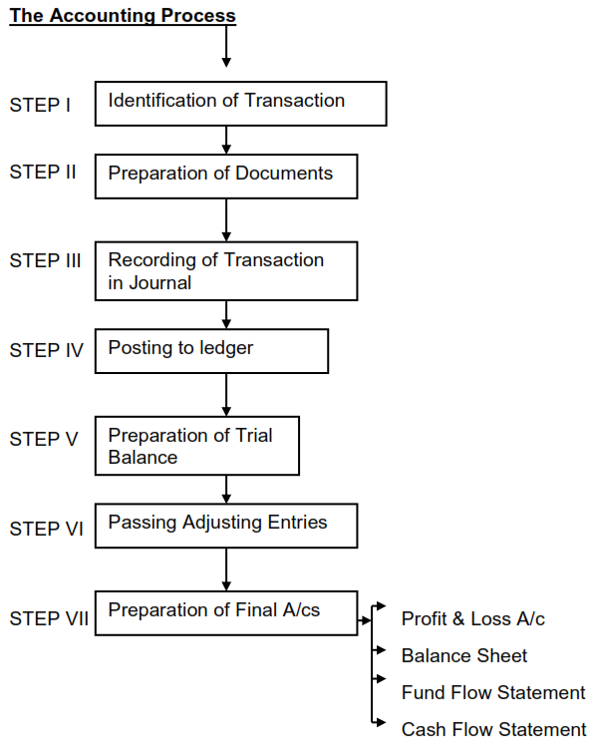
ACCOUNTING PROCESS

Slide 32
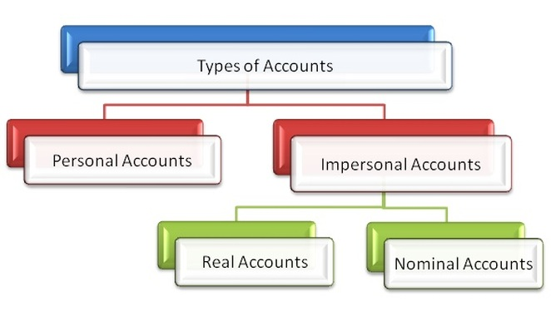
TYPES OF ACCOUNTS & RULES

Slide 33
Personal Accounts:
Accounts which shows transactions related to persons are called Personal Accounts.
A separate account is kept on the name of each person for recording the benefits received from or given to the person.
Ex: Gopal’s A/C, SBI A/C, ACS Finance Ltd. A/C, Capital A/C, etc.
Rule:
Debit - The Receiver
Credit - The Giver

Slide 34
Real Account:
The accounts relating to properties or assets are known as Real Accounts.
Every business needs assets such as machinery, furniture, etc., for running its activities.
A separate account is maintained for each asset owned by the business.
Ex: cash A/C, furniture A/C, building A/C, machinery A/C etc.
Rule:
Debit - What comes in
Credit - What goes out

Slide 35
Nominal Accounts:
Accounts relating to expenses, losses, incomes and gains are known as Nominal Account”.
A separate account is maintained for each item of expenses, losses, income or gain.
Ex: Salaries A/C, stationery A/C, wages A/C, postage A/C, rent received A/C, etc.
Rule:
Debit - All expenses and losses
Credit - All incomes and gains

Slide 36
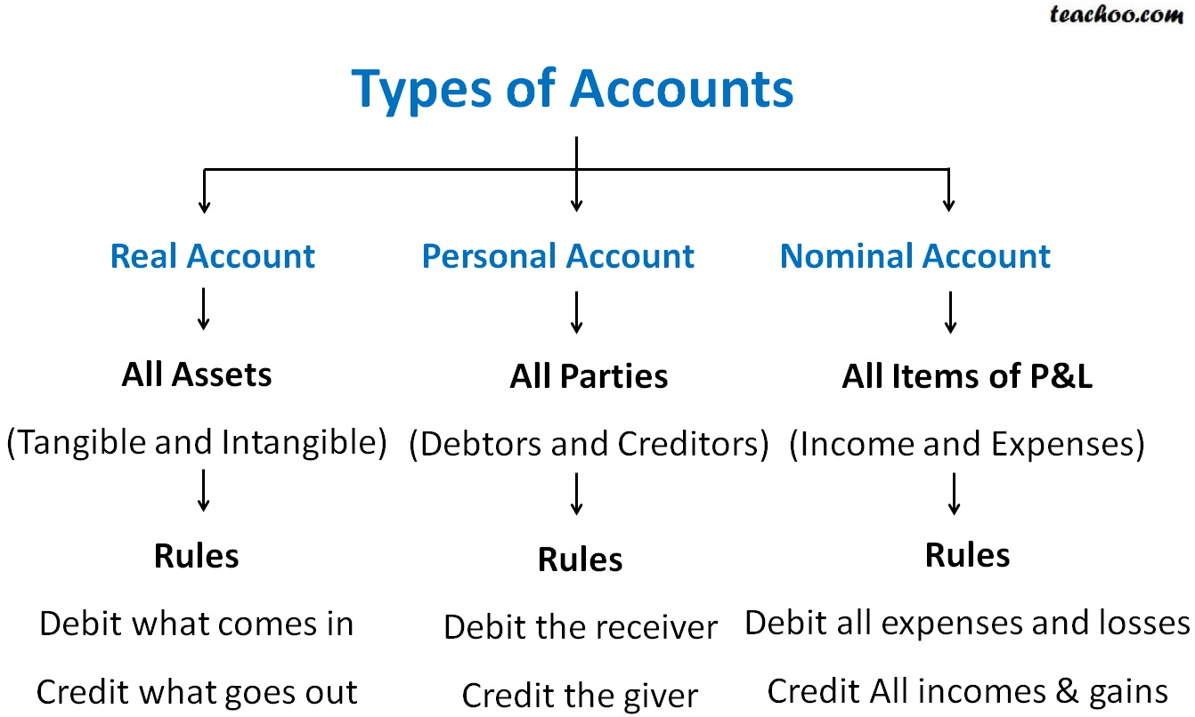

Slide 37
JOURNAL
The word Journal is derived from the Latin word ‘journ’ which means “a day”.
Journal is the first book in which transactions are recorded in chronological order (date wise), the moment they take place in the business.
It is also called Day Book, Book of original entry, First entry and Prime Entry book.
The process of recording a transaction in the journal is called “Journalising”.
The entries made in the book are called “Journal Entries”.

Slide 38
Journal Entries in the Books of ……….
Date | Particulars | L.F. No | Debit Rs. | Credit Rs.
2020 10-Jan | Cash A/c Dr. To Capital A/c (Being started business with cash) |  | 500 | 500

Slide 39
Date: To write the date of the transaction.
Particulars: To write the names of the accounts and its description.
Every entry has two aspects i.e. Debit and Credit.
The name of the account to be debited is written on left side followed by “Dr.” (indicates Debit).
The name of the account to be credited is written in next line using “To” before the account name.
In next line the description of the transaction is written within brackets, starting with the word “Being”.

Slide 40
Ledger Folio (L.F. No.): To write the page number of the account in ledger.
Debit (Rs.): To write the amount to be debited.
Credit (Rs.): To write the amount to be credited.

Slide 41
LEDGER
A ledger is a book which contains various accounts.
The process of transferring entries from journal to ledger is called “Posting”.
Posting into ledger is done periodically, may be weekly or fortnightly as per the convenience of the business.
The format of ledger A/c is “T” shape.
The left hand side is debit side (Dr.) and right hand side is credit side (Cr.).

Slide 42
Dr. Name of the Account Cr.
Date | Particulars | JF. No | Amount (Rs.) | Date | Particulars | JF. No | Amount (Rs.)

Slide 43
Date: Date of transaction as noted in Journal.
Particulars: Every entry on the debit side of this column must begin with the word 'To' and on credit side with the word 'By'.
On the debit side of the account after the word 'To' write "Name of the Credit Part of the Journal entry.
On the credit side of the account, after the word' By' write 'Name of the Debit Part of the Journal entry'.
Journal Folio: Write page number of Journal from where the entry is posted.
Amount: Write the amounts of the transaction.

Slide 44
Balancing an Account:
Accounts are balanced with a view to prepare the final accounts.
Take the totals of the two sides of account and enter the higher balance on both the sides.
Enter the difference amount and write “To/By balance c/d” against the balance.
The balance is brought forward at the beginning of next period written as “To/By balance b/d”.
If the debit and credit balance are equal it implies nil balance.

Slide 45
SUBSIDARY BOOKS
As Business transactions are numerous and large in size, the Journal may be split up into number of separate Journals to record particular type of transaction.
These journal are known as the subsidiary books. Some of the subsidiary books are:
Purchase Book
Purchase Return / Return Outward Book
Sales Book
Sales Return / Return Inward Book
Bills Receivable Book
Bills Payable Book
Journal Proper

Slide 46
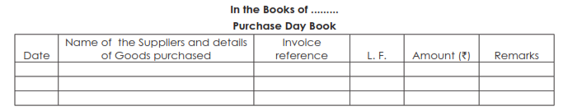
Purchase Day Book
The purchase day book records the transactions related to credit purchase of goods only.
It follows that any cash purchase or purchase of things other than goods is not recorded in the purchase day book.
Periodically, the totals of Purchase day book are posted to Purchase account in the ledger.
The specimen Purchase day book is given below:

Slide 47
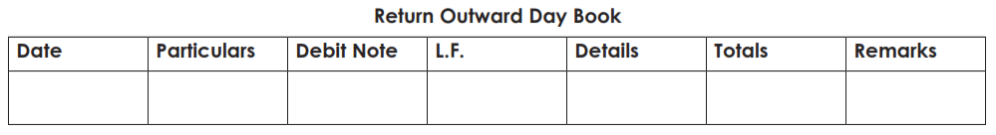
Purchase Returns/ Return Outward Book
This book contains the transactions relating to goods that are returned by us to our creditors.
Example, goods broken in transit, not according to the sample etc.
The specimen Purchase day book is given below:

Slide 48
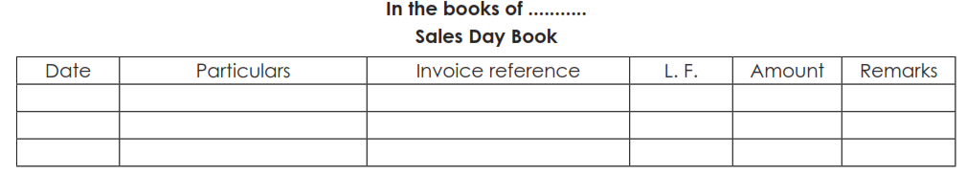
Sales Day Book
The sales day book records transaction of credit sale of goods to customers.
Sale of other things, even on credit, will not be entered in the sales day book but will be entered in Journal Proper.
If goods are sold for cash, it will be entered in cash book. Total of sales day book is periodically posted to sales account in the ledger.
The specimen of a sales day book is given below:

Slide 49
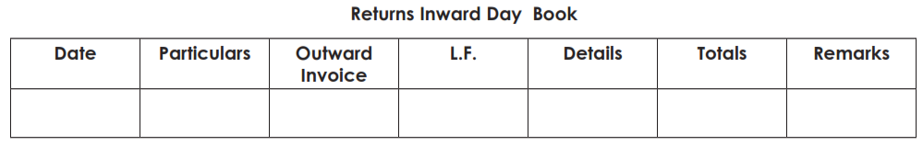
Sales Returns/ Return Inward Book
The transactions relating to goods which are returned by the customers for various reasons, such as not according to sample, or not up to the mark etc. contain in this book.
Generally when a customer returns good to suppliers he issues a Debit Note for the value of the goods returned by him.
Similarly the supplier who receives those goods issues a Credit Note.
The specimen of a sales returns book is given below:

Slide 50
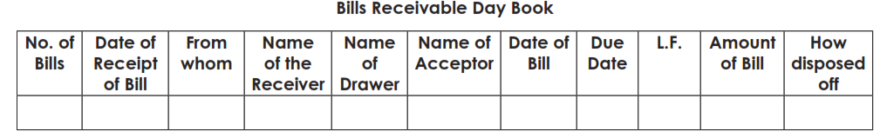
Bills Receivable Book
It is such a book where all bills received are recorded and therefrom posted directly to the credit of the respective customer’s account.
The total amounts of the bills so received during the period (either at the end of the week or month) is to be posted in one sum to the debit of Bills Receivable A/c.
The specimen of a Bills receivable book is given below:

Slide 51
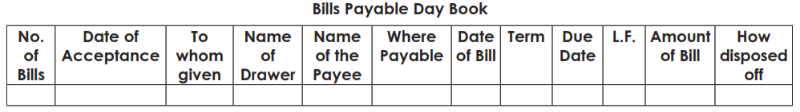
Bills Payable Book
Here all the particulars relating to bills accepted are recorded and therefrom posted directly to the debit of the respective creditor’s account.
The total amounts of the bills so accepted during the period (either at the end of the week or month ) is to be posted in one sum to the credit of Bills Payable Account.
The specimen of a Bills payable book is given below:

Slide 52
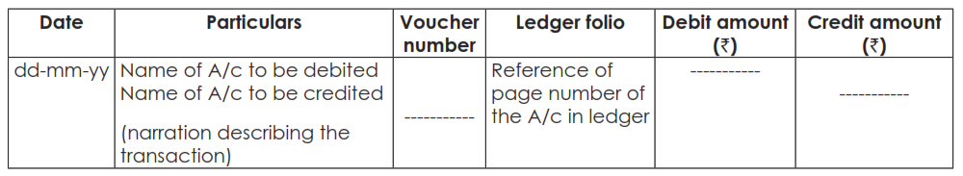
Journal Proper
Credit transactions that cannot be entered in any other subsidiary book are entered in journal proper.
It will cover purchase or sale of assets, expense accruals, rectification entries, adjusting entries, opening entries and closing entries.

Slide 53
TRAIL BALANCE
The fundamental principle of double entry book keeping is that debit must be equal to credit.
All ledger accounts are balances.
A debit balance in a general ledger account indicates an excess of debit side over credit side of the account.
A credit balance in a ledger account indicates the excess of credit side over debit side of the account.

Slide 54
A trial balance is a summary of all the ledger balances outstanding as on particular date.
List of debit balances and credit balances should be equal. It said that Trial balance is tallied.
When trial balance tallies are establishes the arithmetical accuracy of record.
It is a statement prepared before preparing the final accounts.
It is a link between books of account and final accounts i.e. the Trading & Profit & Loss A/c and Balance Sheet.

Slide 55
Trial balances are of two types:
Gross Trial Balance: It is prepared by taking all ledger account debit total and credit total, instead of considering ledger balances, as on a particular date.
Net Trial balance: It is list of debit & credit balance, taken from ledger accounts on particular date. Normally, net trial balance is prepared, since it is transferred to final accounts and personal and real accounts balance are carried forward from current year to subsequent year.

Slide 56
Trail balance of ……………… as on …………
Name of account (Particulars) | Debit Amount (Rs.) | Credit Amount(Rs.)

